Slide 1
Car price prediction using linear regression
Prepared by Shakil Ahammed

Slide 2
Overview
This is a python project for building a linear regression model that is used to predict used car prices from a given dataset using machine learning.

Slide 3

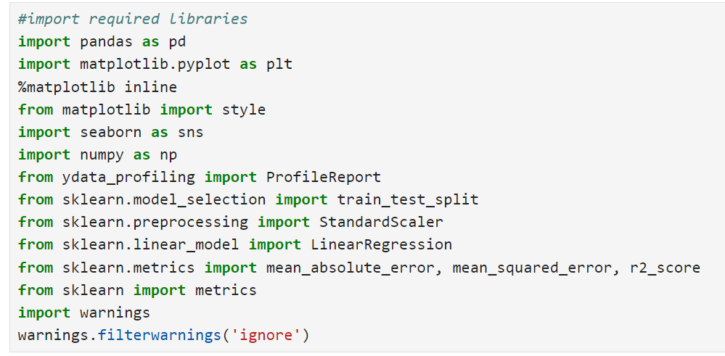
Import all required libraries in one cell.

Slide 4
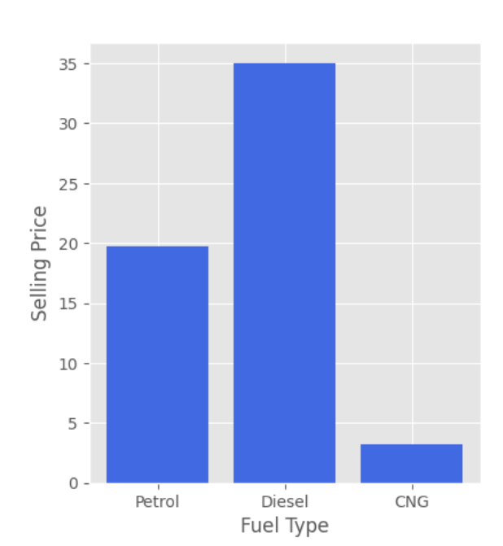
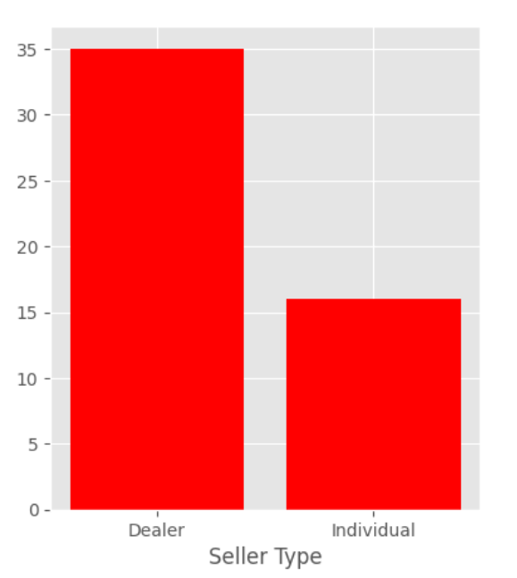
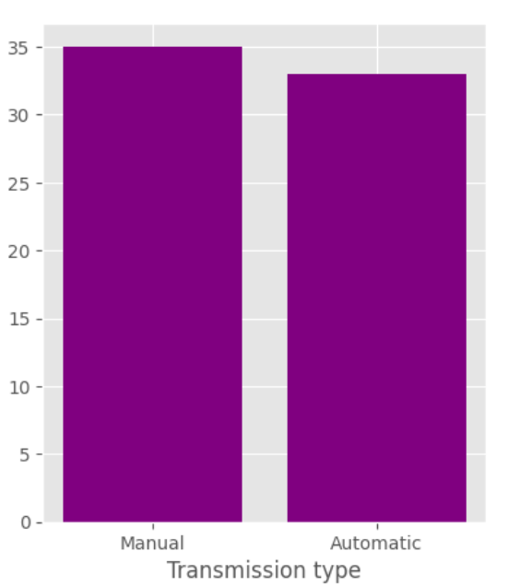
Insights
Visualizing categorical data columns.

Slide 5
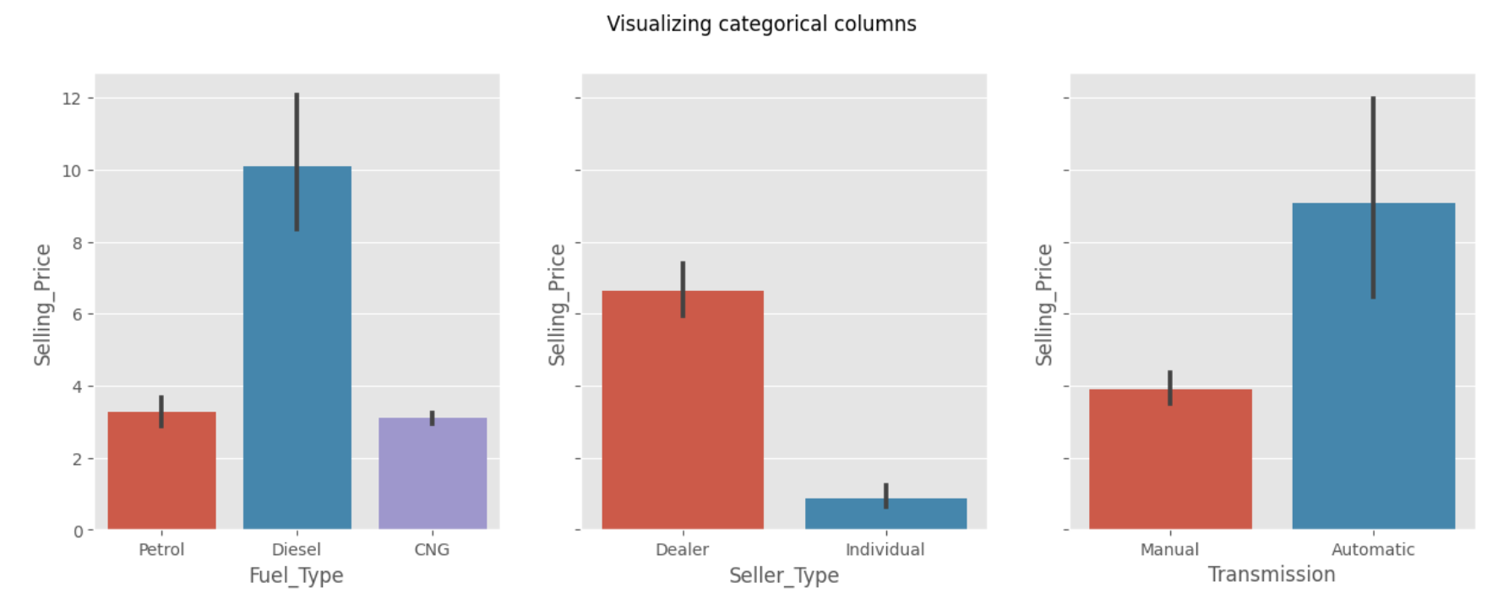
Visualizing categorical data columns.

Slide 6
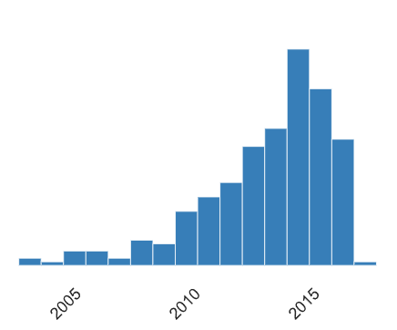
Car sales by year.

Slide 7
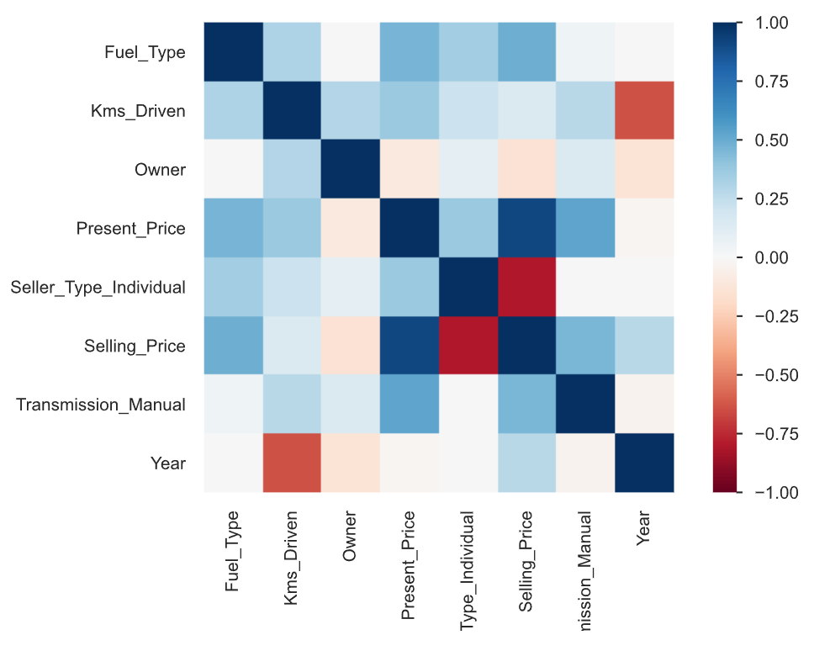
Correlation between each column.

Slide 8
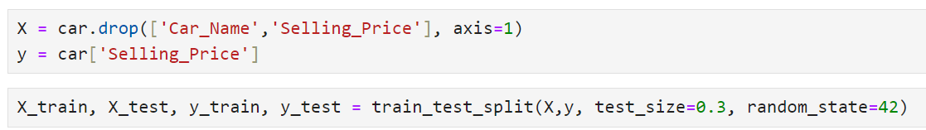
Splitting the data
X are the predictors, and y is the output. What we want to do is create a model that will take in the values in the X variable and predict y with a linear regression algorithm. We will use the SciKit-Learn library to create the model.

Slide 9
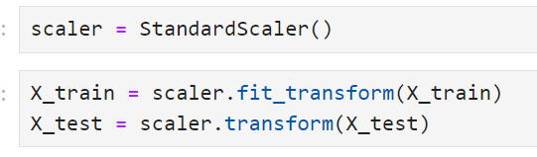
Standarize the X_train and X_test using StandardScaler.

Slide 10
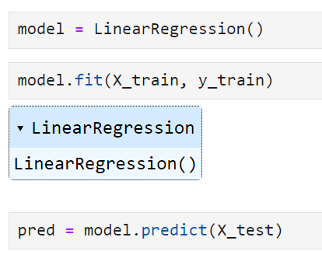
we create the model and feed the training data to it. This model will tell us which input has the biggest impact in the output .

Slide 11
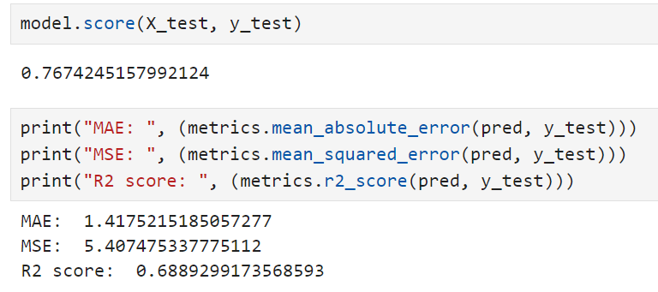
Evaluation of the model. Our predicting model accuracy is 76%. Model is working good.

Slide 12
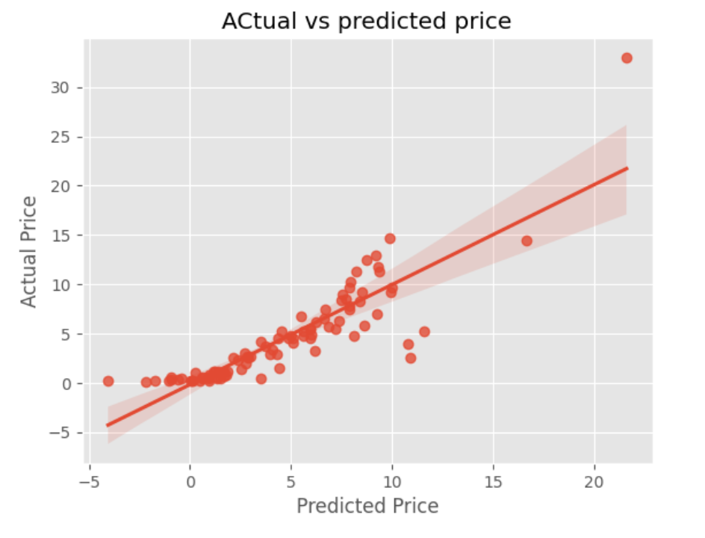
Actual vs predicted price. We see that it’s a linear relationship.

